Slide 1


Slide 2
Evaluation of Training
, Evaluation and Quality PlanWP5 - Project assurance and efficiency
5.2. Monitoring, Evaluation and Quality assurance and efficiency
Jordan, September 2018, CRE.THI.DEV

Slide 3
Evaluation of the training in Greece
What are the most useful activities/visits you had during your stay in the EU hosts? Why
Visits to IDEA and Engino in Cyprus and useful presentations with live case studies
How to infuse change and to impact a traditional culture
Technical visit to Corallia and Impact Hub , in Athens “Lean startup” lecture, fundraising and Innovation structure in Greece, University – business cooperation
Promotion of CTI services through communication channels and techniques

Slide 4
What are the most useful activities/visits you had during your stay in the EU hosts? Why
How to build business canvas to establish an e-learning center at University of Jordan according to canvas model
Exposure to ARCA’s incubation process and how they select startups
ARCA startup visit, startup management
European network
Innovation transfer process and approaches
The visit of the hospital in Italy because it is a good example

Slide 5
What are the most useful activities/visits you had during your stay in the EU hosts? Why
The most useful visit to Department of Industrial and Digital Innovation because The DIID was inspired by the innovative concept of Triple Helix in which the University Research, Education and Technology Transfer are integrated into a single training model (Italy)
Presentations were rich and useful because the presenters were specialized in their fields. Field visits were very interesting and well selected and also match the project objectives. Lessons learned were very good for me, especially to see a practical and live case study (Cyprus)

Slide 6
What are the most useful activities/visits you had during your stay in the EU hosts? Why
Lectures, discussion, teamwork (Porto)
Explore some companies in Porto

Slide 7
What are the least useful activities/visits you had during your stay in the EU hosts? Why.
Some long lectures
Technical visit to National Center for Scientific Research “Demokritos and Innovathens in Athens,
I think the activities and the visit have been carefully selected (Cyprus and Italy)
Most of these presentations were general information, which can be downloaded from the websites
Some videos were of bad voice quality

Slide 8
List the most useful lesson learned
The network is very important to connect entrepreneurs and successful company
Learning from success stories for Entrepreneurship and innovative companies
Sources of funding are different in earlier stages than advanced stages
Risks and challenges are part of the journey let’s accept it, face it, even enjoy it. The dream is bigger, faith in one's abilities is crucial
To be updated with innovation field in world institutions, to make national network for Jordanian Entrepreneurs
Innovation, incubator, fundraising for the project

Slide 9
List the most useful lesson learned
The importance of clusters, there is a procedure for technology transfer office, the cooperation between academia and business
To have faith that R&D and technology transfer is a way to sustainable development. To search for alternatives and make plan B & C to choose the most suitable business model for your Technology transfer office.
Introduction to CTIs
Business plan
Model Canvas
Building and discussing our own business model
New ideas to the selection process of startups

Slide 10
List the most useful lesson learned
There are a variety of information exchanges both formal and informal that are effectively being utilized for technology transfer
Expand Collaborative Research and Development (R&D) Partnerships in the Public and Private Sector
Create a sense of community among public agencies, universities, and industries to help energize these groups to enhance a culture of innovation
You must plan before you start the work

Slide 11
List the most useful lesson learned
The model in which startups work
Startup assessment
Startup management
The importance to know your client
European Innovation network
We learned a practical approach of how the CTI works
Collaboration is the base to do any work or project
EU Opportunities (H2020 and other programmers) so important to help researchers in my University to get the fund.

Slide 12
How was the study visit useful to your work? What type of knowledge you will take back home?
Understanding the TTO services from UCY,
Startup management (ecosystem) is essential to make sustainable innovation
Field visits
New information about how business incubators are working
The tools I have learnt will help me as a technology transfer officer to help others in developing their ideas

Slide 13
.
How was the study visit useful to your work? What type of knowledge you will take back home?
To see startups and innovative companies growing up.
Innovation structure in Greece
Business – University cooperation because this is important to build incubator in my university
Principles and sources of funding
How to build a business plan according to canvas model (UCY & ARCA)
To consider canvas model in our work

Slide 14
How was the study visit useful to your work? What type of knowledge you will take back home?
The assessment and management methods were very useful and I recommend to be used in our center in Jordan
How to create a strategy for innovation and linkage between Academia and Industry.
Innovation assessment

Slide 15
How was the study visit useful to your work? What type of knowledge you will take back home?
In the social impact realm, examining your leadership style and your personal shortcomings is essential to ensuring a successful year of moving your ideas forward and making an impact on those you set out to help. No leader or entrepreneur should forego the opportunity to reflect on their lessons learned and use these lessons as a springboard for growth in the coming year.

Slide 16
To what extent did you gain confidence in the following topics you learnt?
(Average percentage of satisfaction for all training weeks)
Leadership and presentations 85,21%
Open Innovation and living labs 85,00%
Transfer of technology processes 79,37%

Slide 17
The host institute environment
(Average percentage of satisfaction for all training weeks)
The training was suitable and in good environment 88,06%
The study visits were relevant and useful 85,00 %
The people we met during the visit were of great value added 94,70%

Slide 18
What were the biggest obstacles and problems?
Some presentations were very long
Finding a proper funding to start new innovative ideas (high risk investment)
Transportation (in Greece and Cyprus)
The trainees are not of the same level (gathering Professors with students??) (Greece)
I have one problem. The training program was theoretical and did not contain practical training

Slide 19
What were the biggest obstacles and problems?
The visits were more restricted to presentations and facilities and less to examples and operations (Greece)
We need an exchange of staff with ARCA to gain from their experience
No real obstacles in Cyprus and Italy
Perfect (Portugal)
No outside visits or activities

Slide 20
Your suggestions for improvement
In the first week of training there was a need for more time to be devoted to the increase in knowledge gained from the training, as well as a need for more visits to Entrepreneurship centers and startups. This need seems to be satisfied in the 3rd week of training.
Emphasize on visits and interactive lectures and open dialogues. Training environment to be more interactive. Adapt a variety of training methods. (Greece).
Stay more days with successful real cases which are incubated in ARCA

Slide 21
Your suggestions for improvement
It would be more beneficial to host existing companies and companies which already exist in the incubator to talk about their experience
I need to learn some skills like Industry and Law languages which support us in case of Negotiation when transferring a new technology
Visit of a chamber of Industry and commerce
Entrepreneurship should be part of the academic plan in the Universities.

Slide 22
Your suggestions for improvement
Everything was more than perfect. I wish we had a visit to Entrepreneurship centre to have a look at the facilities they had
It was very good, maybe if other business models were discussed and compared to canvas
Always try to get applied examples
More days for training and less hours
To cover visits with success stories, to meet some of them

Slide 23
Your suggestions for improvement
More practical visits to organizations other than the hosting company
The training needs more than one week to do perfect

Slide 24
“I would like to thank UCY and the EU for giving me this opportunity to learn new stuff which I will share with my University when I get back to Jordan”
“We need an exchange of staff with ARCA to gain from their experience”
“Perfect” (P&B)
“Thank you for this opportunity, it was really valuable and I enjoyed my time in Greece”

Slide 25
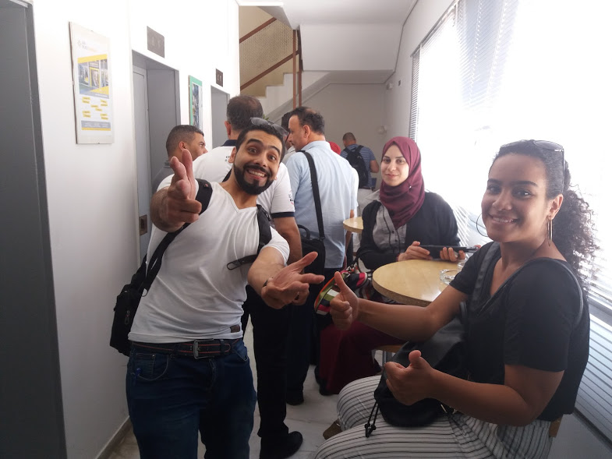
Thank you for your attention

